Slide 1
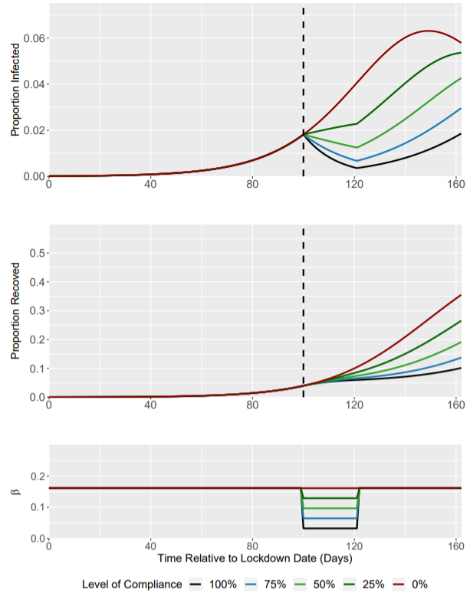
SPI-M Slide
Level of Compliance (%) | R₀ under Lockdown (Baseline = 1.5) | I(t) at Lockdown Trigger | I(t) at 3 weeks post-Lockdown | Time to Return to Pre-lockdown I(t)
100 | 0.3 | 0.0182 | 0.004 | 41
75 | 0.6 | 0.0182 | 0.007 | 26
50 | 0.9 | 0.0182 | 0.013 | 10
25 | 1.2 | 0.0182 | 0.023 | N/A
0 | 1.5 | 0.0182 | 0.041 | N/A
Interpretation
For a lockdown compliance of 100% (R₀ = 1.5 -> 0.3), I(t) returns to pre-lockdown levels (0.0182) ~41 days after cessation of the 3 week intervention.
Dashed line represents the start date for the 3 week intervention.

Slide 2
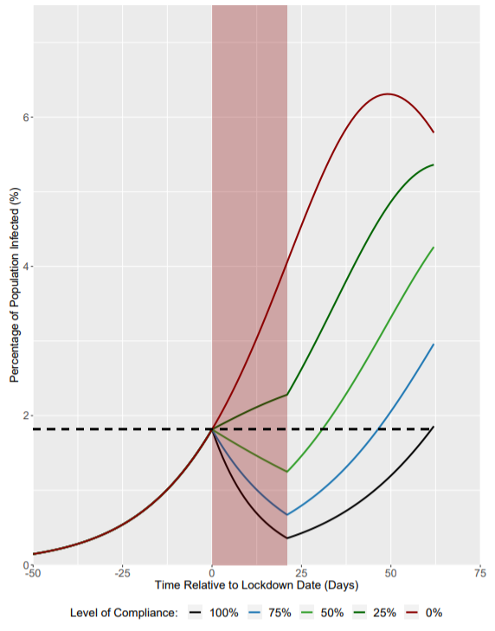
SPI-B Slide
FOR ILLUSTRATION ONLY
Level of Compliance (%) | R₀ under Lockdown (Baseline = 1.5) | Population Infected at Lockdown Initiation (%) | Population Infected at 3 weeks post-Lockdown (%) | Days to Return to Pre-lockdown level of % Infected
0 | 1.5 | 1.82 | 4.1 | N/A
25 | 1.2 | 1.82 | 2.3 | N/A
50 | 0.9 | 1.82 | 1.3 | 10 Days
75 | 0.6 | 1.82 | 0.7 | 26 Days
100 | 0.3 | 1.82 | 0.4 | 41 Days
Interpretation
For a lockdown compliance of 100% (R₀ = 1.5 -> 0.3), the percentage of the population that is infected returns to pre-lockdown levels ~41 days after cessation of the 3 week intervention.
Red shading represents 3 week lockdown period.
Dashed line represents the percentage of the population that is infected when the lockdown is initiated (1.82%).
Red dots represent the time at which the infected population under compliance scenarios: 100%, 75% and 50% return to pre-lockdown levels.

